Slide 1

SIT105 – Thinking Technology and Design Class 05
Arguments &
Truth Tables
Dr. Frank Jiang
Frank.Jiang@deakin.edu.au

Slide 2
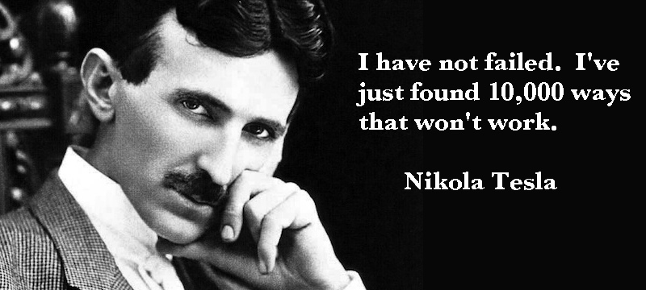
Critical Thinking Quote of the Class
Nikola Tesla was a Serbian American inventor, electrical engineer, mechanical engineer, and futurist. Most well known for harnessing light, inventing x-rays, radio, and alternating current.
Even when our efforts don't seem to provide results, that doesn't mean we've failed or should give up! Consider them part of the process of finding what does work.

Slide 3

So to begin, let’s look at arguments
This week’s ULO – [1] Apply critical thinking techniques and IT discourse to identify and analyse problems from technical and non-technical perspectives.

Slide 4
Arguments! What are they?
Arguments are one of the ways used to settle issues.
The process of an argument is actually where 2 or more people are debating (responding to each other) and making arguments on a particular topic.
Moving away from just stating claims but actually defending these claims by providing reasons.
Arguments are actually claims backed by reasons that are supported by some form of evidence.
Arguments attempt to support a claim by giving reasons for believing it (the premises).
The issue is “Whether or not the claim is acceptable given the reasons.”

Slide 5
So What Do We Need to Know to Begin With? … ….Claims!
A claim is a sentence that is used to make a claim capable of being true or false.
Claims are the basic units of arguments.
An argument is a set of claims (2 claims) where a premise, supports another (particular one) of them called the conclusion.

Slide 6
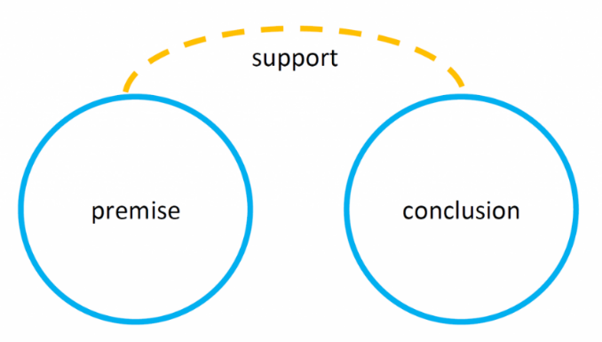
A Rundown on Arguments! ..What are they?
A conclusion is:
A claim, and
Supported by one or more premises.
A premise is:
A claim too, and
Used as a reason for believing the conclusion.

Slide 7


Arguments… A few examples
Each of the following premises are highlighted in blue and conclusion in red.
My 1:30pm train was cancelled because it was involved in an accident at 1:20pm.
Jane likes blue so her sister likes blue too.
I study hard because I want a good job.
The PlayStation network is down because hackers broke in and stole all the data.
A claim used as a reason for believing the conclusion.

Slide 8

Quick Thinking Task ! Premise/Conclusion
An argument has a premise and a conclusion. The premise supports the conclusion!
(sometimes the conclusion can be 2^{nd!})
For example:
Jack is taller than Paul, and Paul is taller than Jill. Therefore, Jack is taller than Jill.
Which is the premise? Which is the conclusion?
Answer

Slide 9

Now let’s look at the theme of this week.
Societal and Scientific Arguments around Video Games!

Slide 10


Do Video Games Make People More Violent?
A 2011 study by the Center for European Economic Research found that although violent video games might increase aggression they also have a paradoxical effect of reducing crime.
This is possibly because the time spent playing games reduces time spent engaged in more antisocial actives.
The study states that: violent video games "paradoxically may reduce violence while increasing the aggressiveness of individuals by simply shifting these individuals out of alternative activities where crime is more likely to occur."
Cunningham, A. Scott; Engelstätter, Benjamin; Ward, Michael R. (2011). "Understanding the effects of violent video games on violent crime" (PDF). ZEW Discussion Papers 11-042. Center for European Economic Research. p. 25. Retrieved11 November 2014.

Slide 11

Do Video Games Make People More Violent?
Remember: The conclusion is the claim you are making and
the premise is used as a reason for believing the conclusion
Let’s spend 5 minutes to analyse the previous research.
Can you suggest 2 arguments either for, or against?
Premise | Conclusion

Slide 12

Next let’s look at Truth Tables!

Slide 13

Truth Tables … Why do we need them?
It is often difficult to determine the validity of long and/or complex arguments by just reading them!
Truth tables provide:
A visual way to see relationships between claim variables
Ways to determine validity
Important!

Slide 14

Truth Tables – 2 Ways!
There are two kinds of truth tables
Long Truth Table
Short Truth Table
Development of a long truth table normally takes more time…
A short truth table can be done faster than a long truth table but you need to think critically!

Slide 15
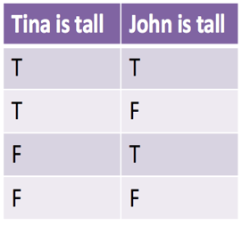
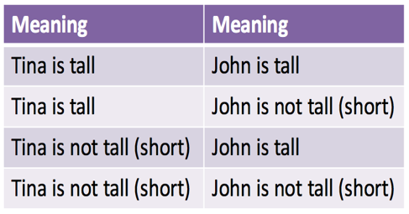
What do we mean by TRUE(T) and FALSE(F)?
Example:

Slide 16
Logic and Types of Claims
There are 4 logic operations that are being used in truth functional arguments:
Negation NOT
Conjunction AND
Disjunction OR
The Conditional IF,THEN

Slide 17
Negation (Not) ~
Whatever truth value a claim may have, the negation will result in the other value.
Example, let p = Tina is tall
Then not (Tina is tall) = Tina is short
‘~p’ represents ‘not p’
p | ~p (i.e., not p)
T | F
F | T
p = Tina is tall

Slide 18
Conjunction (and) ●
A conjunction is a compound claim made up of two simpler claims
Example, Tina is tall and John is short
‘●’ represents ‘and’ (sometimes ʌ is used)
p | q | p ● q
T | T | T
T | F | F
F | T | F
F | F | F
p = Tina is tall
q = John is short
True value is when both claims are True, all other times False

Slide 19
Disjunction (or) V
A disjunction is a compound claim made up of two simpler claims
Example, Tina is tall or John is short
‘V’ represents ‘or’
p | q | p V q
T | T | T
T | F | T
F | T | T
F | F | F
p = Tina is tall
q = John is short
False value is when both claims are False, all other times True

Slide 20
Conditional →
A conditional is a compound claim made up of two simpler claims
E.g. If Jack is my son, Jack is younger than me
‘→’ represents the conditional operator
p | q | p → q
T | T | T
T | F | F
F | T | T
F | F | T
p = Jack is my son
q = Jack is younger
False value is when the first claims is True and the second claims is False, all others True

Slide 21

Summary of Steps in Truth Tables
1. Summarise the argument
2. Calculate the number of rows
3. Draw the table
4. Fill the table
5. Identify whether the argument is valid or invalid

Slide 22
Let’s Begin with Long Truth Tables!

Slide 23
Steps Involved in a Long Truth Table
Summarise the argument (cont.)
Firstly create a single variable code for each, something that relates to the claim/s used… apple = a.
Use the logical operators we looked at earlier: ~/V / /
Michael does NOT like apple = ~a
Michael likes apple OR banana = a V b
Michael likes apple AND banana = a b
IF Michael likes apple, THEN he likes banana = a b

Slide 24
Steps Involved in a Long Truth Table
2. Calculate the number of rows that table needs:
The number of rows = 2^{n}
n is the number of variables that you have when you summarise the argument.
If there is positive and negative of a variable you should only count it once: a and ~a are both count as one variable
2² = 4
2³ = 8
2⁴ = 16

Slide 25
Steps Involved in a Long Truth Table
3. Draw the table. List all variables as a single form then list premises and the conclusion.
Michael does not like apple = ~a (p1)
Michael likes apple OR banana = a V b (p2)
Therefore, Michael likes banana = b (c) Number of rows: 2² = 4
a | b | ~a _{p1} | a V b _{p2} | b _{c}

Slide 26
Steps Involved in a Long Truth Table
4. Fill the first column:
First column always gets TRUE for half of the number of rows and FALSE for the other half
Number of rows = 4 (first column gets 2 trues and 2 false )
Number of rows = 8 (first column gets 4 trues and 4 false )
Number of rows = 16 (first column gets 8 trues and 8 false )
a | b | ~a _{p1} | a V b _{p2} | b _{c}
T
T
F
F

Slide 27
Steps Involved in a Long Truth Table
4. Fill the next column:
If column 1 has 2 T and 2 F the next column needs to have 1 T and 1 F.
If column 1 has 4 T and 4 F the next column needs to have 2 T and 2 F.
If column 1 has 8 T and 8 F the next column needs to have 4 T and 4 F.
a | b | ~a _{p1} | a V b _{p2} | b _{c}
T | T
T | F
F | T
F | F

Slide 28
Steps Involved in a Long Truth Table
4. Fill the table cells:
Apply operations:
Negation (~) when T then ~T = F Conjunction ( ) The only T answer is when both variables are T Disjunction (V) The only F answer is when both variables are F Conditional ( → ) The only F answer is when the first variable is T and the second variable is F
a | b | ~a _{p1} | a V b _{p2} | b _{c}
T | T | F | T | T
T | F | F | T | F
F | T | T | T | T
F | F | T | F | F

Slide 29
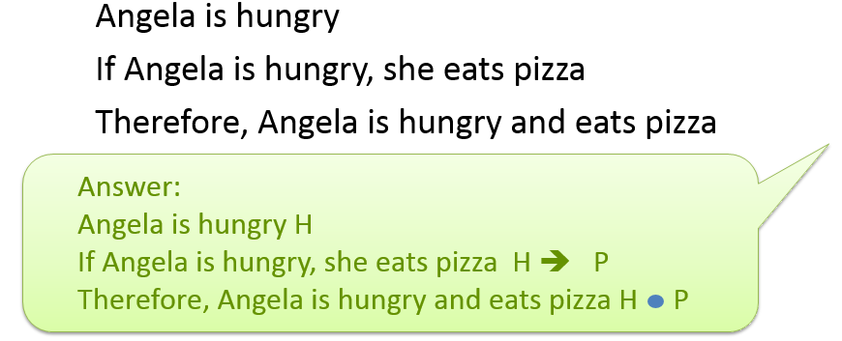
Steps Involved in a Long Truth Table
Exercise: Let’s tackle a long truth table for this new argument!
H | P | H _{p1} | H -> P _{p2} | H P _{c}

Slide 30
Steps Involved in a Long Truth Table
Answer: Fill the table for Angela's Argument
H | P | H _{p1} | H -> P _{p2} | H P _{c}
T | T | T | T | T
T | F | T | F | F
F | T | F | T | F
F | F | F | T | F
Valid or invalid argument? Find out next slide!

Slide 31
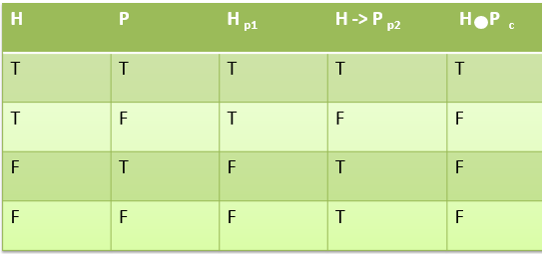
Steps Involved in a Long Truth Table
Valid! – no conclusion which is false with all true premises!
5. Find whether an argument is valid or invalid
REMEMBER : an argument is invalid when it has a false conclusion and all premises true.
If you find the conclusion that is F when all premises are T the argument is invalid; otherwise it is valid.
Valid!
Based on above truth table, is this argument valid or invalid?

Slide 32
Now with Short Truth Tables!

Slide 33
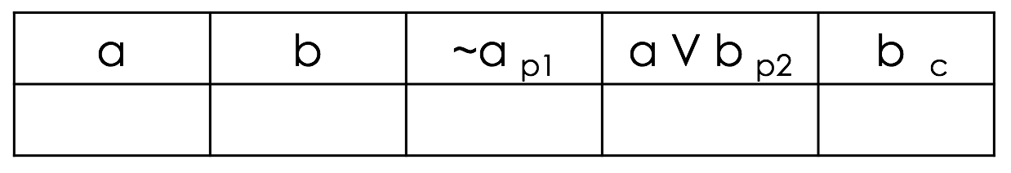
Short Truth Table
We will use our example from earlier to conduct the short truth table.
Michael does not like apple = ~a (p1)
Michael likes apple OR banana = a V b (p2)
Therefore, Michael likes banana = b (c)

Slide 34
Steps to Develop a Short Truth Table
Draw a table with only one row (Excluding Header)
In header list single variables first then premises and at the end conclusion(same as long truth table)

Slide 35
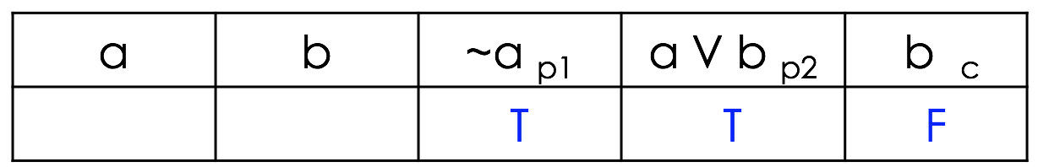
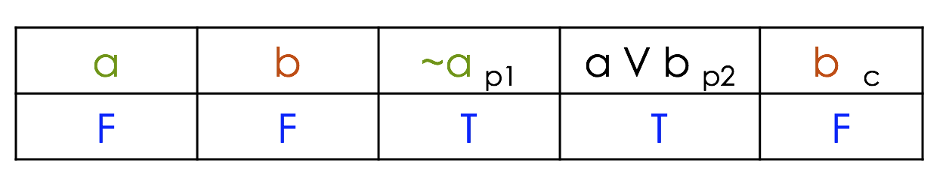
Steps to Develop a Short Truth Table
2. First assume that this is an invalid argument
REMEMBER : an argument is invalid when it has a false conclusion
and all premises true
3. Fill the empty cells by considering second step

Slide 36
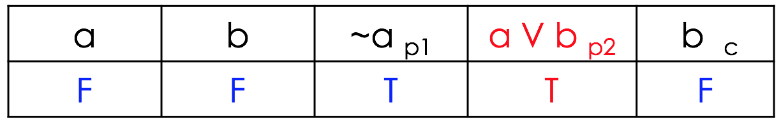
Steps to Develop a Short Truth Table
4. Check whether your assumption (invalid) is correct or not by finding a conflict in the table.
If you have found the conflict it means your assumption is not correct therefore the argument is Valid.
In this case a V b (p2) should be False.
Why? Because (F V F = F) all other times its True!
Valid!

Slide 37


Summary Steps to Develop a Short Truth Table
Draw a table with only 1 row (Consider heading)
Assume that the argument is invalid (F conclusion and T premises)
Fill empty cells by considering second step
Check whether your assumption (invalid) is correct or not by finding a conflict in your table.

Slide 38
In Conclusion…
Arguments attempt to support a claim by giving reasons for believing it (the premises).
An argument normally contains 2 parts.
Each part is a claim.
One part is called the premise, and;
The second part is called the conclusion.
A conclusion is:
A claim, and supported by one or more premises.
A premise is:
A claim too, and used as a reason for believing the conclusion.
Truth tables are a tool to help us to check whether an argument is valid or not.

Slide 39

End of Class!
Any Questions?
Readings:
Understanding The Effects Of Violent Video Games On Violent Crime

